Slide 1



Enterpreneurial
Rohayanti Hassan
Faculty of Computing
Universiti Teknologi Malaysia
This slide contains material that is copied from the book Agile Project Manager_v2_handbook by Agile Business Consortium. All rights reserved. No part of this material may be reproduced or transmitted in any form or by any means without the prior written permission of the copyright owner. This material is used here for educational purposes under the doctrine of fair use, with the intention to support learning and teaching.
For more information, please refer to the original source:
Book Title: Agile Project Manager_v2_handbook Author: Agile Business Consortium
Publisher: Buckland Media Group Limited
Year of Publication: 2017
Please consult the book for further details and complete content.
Mindset

Slide 2
Outline
Entrepreneurial Mindset in Agile Projects (DSDM Context)
Factors Affecting Software Development Costs
Proven Techniques for Estimating Project Budgets
Top-Down Estimation
Bottom-Up Estimation

Slide 3
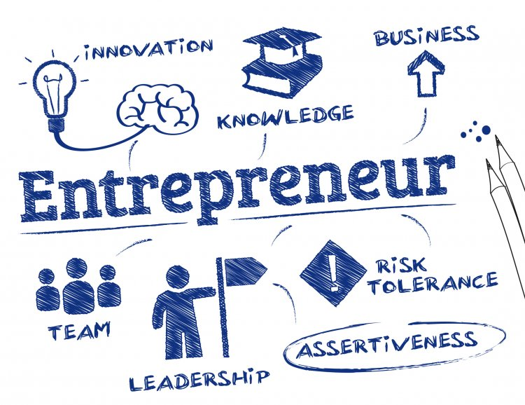
Entrepreneurial Mindset in Agile Projects
(DSDM Context)

Slide 4
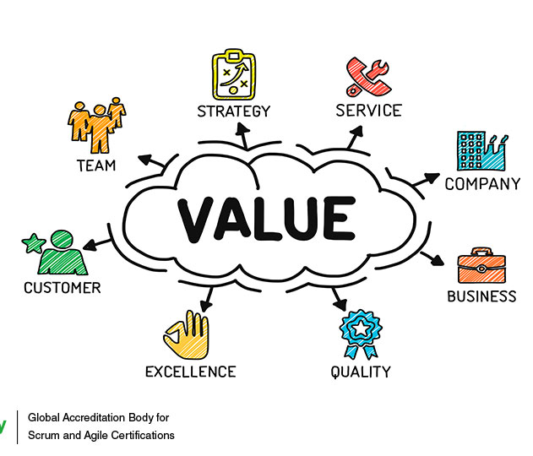
What is an Entrepreneurial Mindset?
An entrepreneurial mindset in Agile software projects focuses on creating real business value, understanding the market and users, managing risk proactively, and ensuring long-term viability of the product.
Rather than measuring success only by technical completion, success is measured by whether the system delivers benefits that stakeholders are willing to support, fund, and use.
Key Characteristics:
• Value-driven decision making
• Customer and market awareness
• Risk-aware and opportunity-focused
• Balancing innovation with control

Slide 5
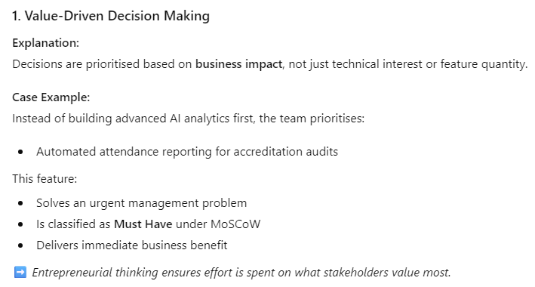
Entrepreneurial Mindset in Example of Software Project
Case: University Smart Attendance & Analytics System
A web-based system used by universities to manage attendance, generate analytics, and provide compliance reports for management.

Slide 6
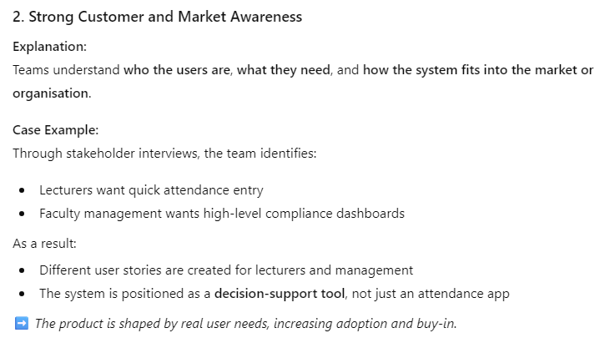
Entrepreneurial Mindset in Example of Software Project
Case: University Smart Attendance & Analytics System
A web-based system used by universities to manage attendance, generate analytics, and provide compliance reports for management.

Slide 7
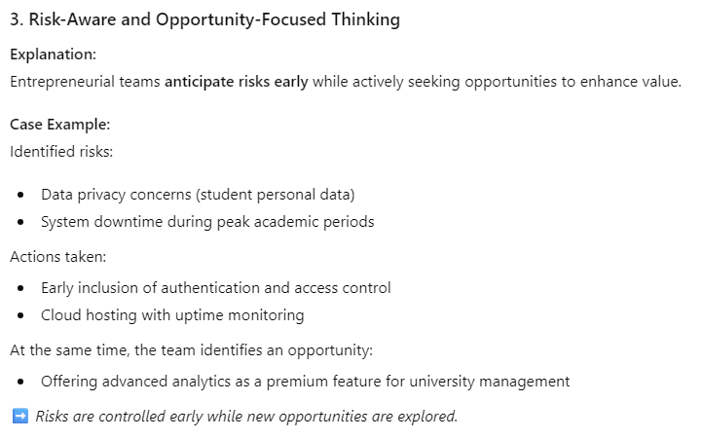
Entrepreneurial Mindset in Example of Software Project
Case: University Smart Attendance & Analytics System
A web-based system used by universities to manage attendance, generate analytics, and provide compliance reports for management.

Slide 8
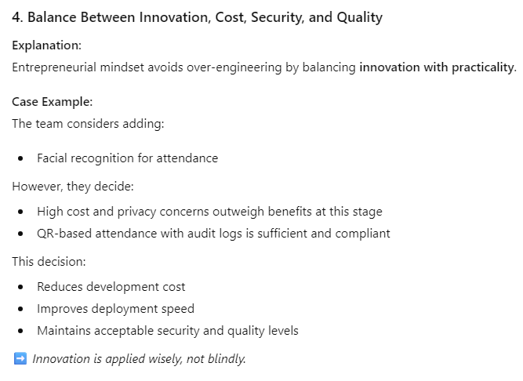
Entrepreneurial Mindset in Example of Software Project
Case: University Smart Attendance & Analytics System
A web-based system used by universities to manage attendance, generate analytics, and provide compliance reports for management.

Slide 9
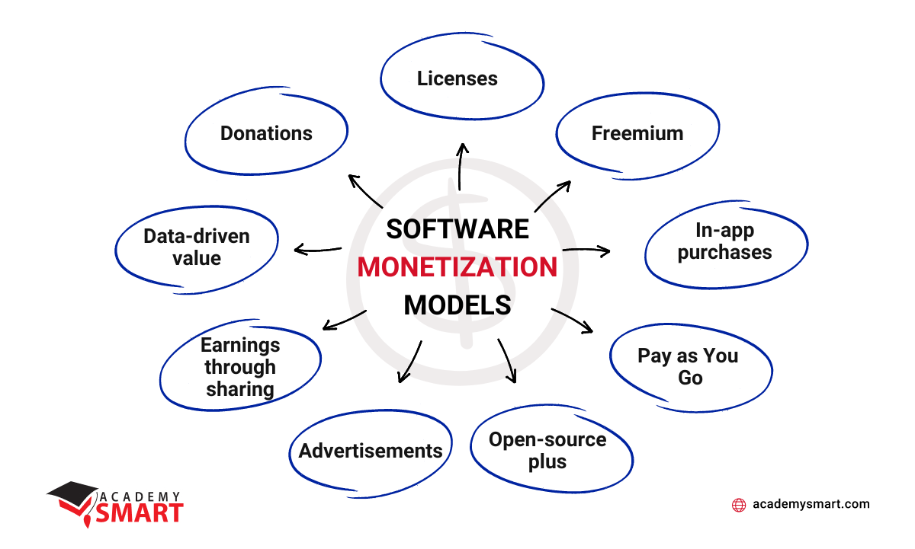
Monetization Strategies

Slide 10
Why Monetization Matters?
Software projects must generate business value.
Common Monetization Strategies:
Subscription model – Monthly / yearly SaaS fees
Usage-based pricing – Per user, per transaction, or per API call
Licensing model – One-time or periodic licence fees
Freemium model – Free core features, paid premium services
Enterprise contracts – Customised solutions with SLA commitments
Agile / DSDM Link:
Influences MoSCoW prioritisation and cost–benefit decisions.
Notes:
Subscription model – Monthly / yearly SaaS fees
Usage-based pricing – Per user, per transaction, or per API call
Licensing model – One-time or periodic licence fees
Freemium model – Free core features, paid premium services
Enterprise contracts – Customised solutions with SLA commitments

Slide 11
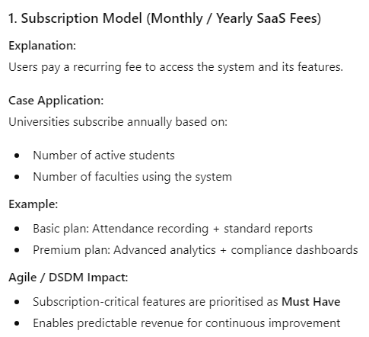
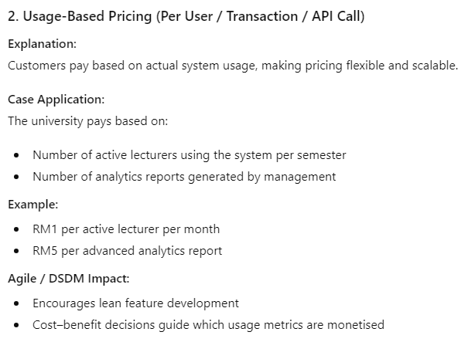
Monetization Strategies
Notes:
Subscription model – Monthly / yearly SaaS fees
Usage-based pricing – Per user, per transaction, or per API call
Licensing model – One-time or periodic licence fees
Freemium model – Free core features, paid premium services
Enterprise contracts – Customised solutions with SLA commitments

Slide 12
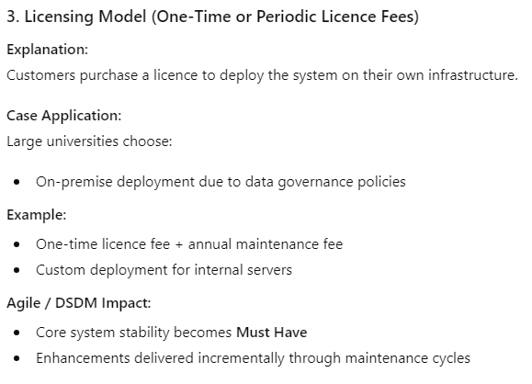
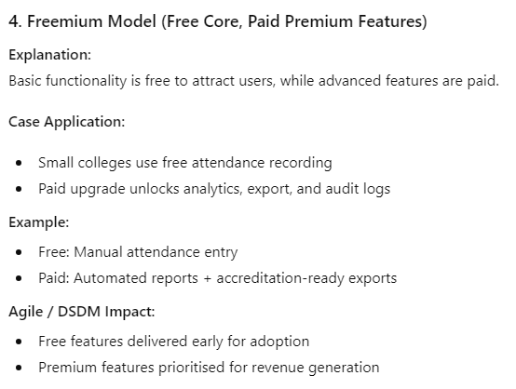
Monetization Strategies
Notes:
Subscription model – Monthly / yearly SaaS fees
Usage-based pricing – Per user, per transaction, or per API call
Licensing model – One-time or periodic licence fees
Freemium model – Free core features, paid premium services
Enterprise contracts – Customised solutions with SLA commitments

Slide 13
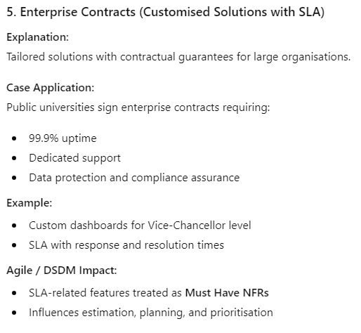
Monetization Strategies
Notes:
Subscription model – Monthly / yearly SaaS fees
Usage-based pricing – Per user, per transaction, or per API call
Licensing model – One-time or periodic licence fees
Freemium model – Free core features, paid premium services
Enterprise contracts – Customised solutions with SLA commitments

Slide 14
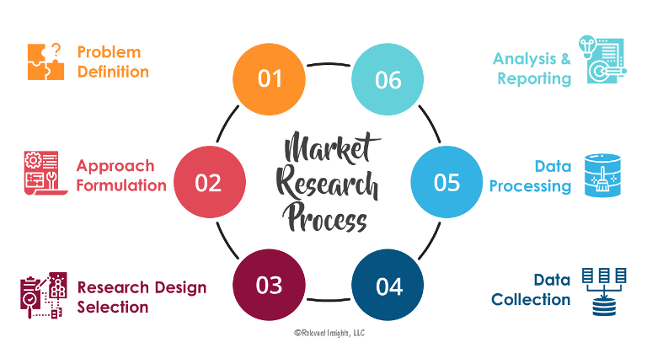
Market Research & Target Audience

Slide 15
Purpose of Market Research
To understand who the system is for, what problems it solves, and why users will adopt it.
Key Activities:
Identify target users (students, lecturers, administrators, enterprises)
Analyse user pain points and expectations
Study competitors and alternative solutions
Validate product–market fit early
Agile / DSDM Link:
Drives user stories and acceptance criteria
Supports iterative feedback and refinement
Reduces risk of delivering low-value features

Slide 16
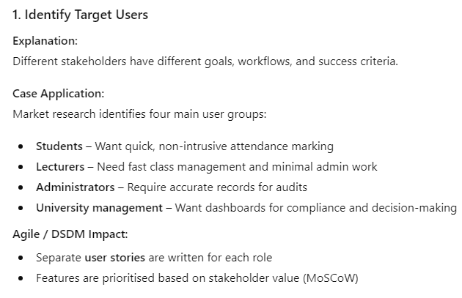
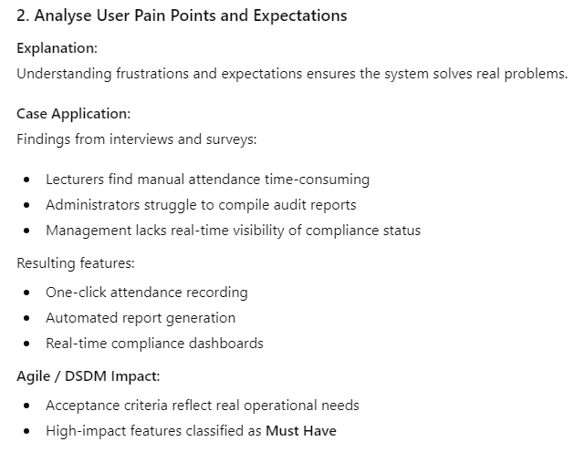
Purpose of Market Research

Slide 17
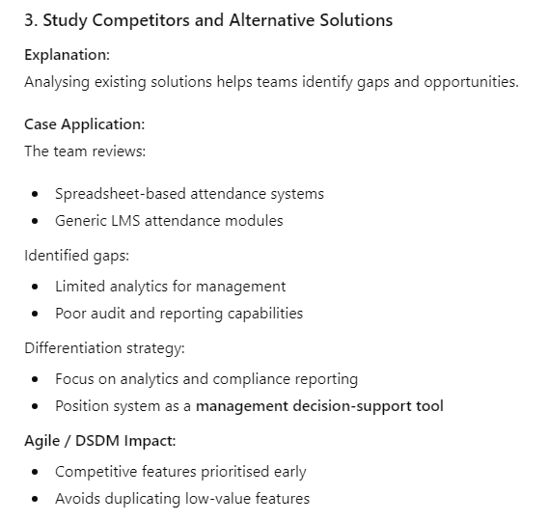
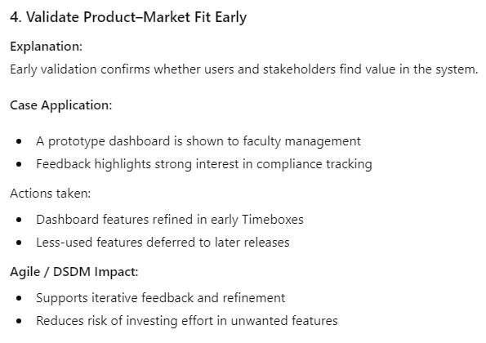
Purpose of Market Research

Slide 18

Scalability and Growth

Slide 19
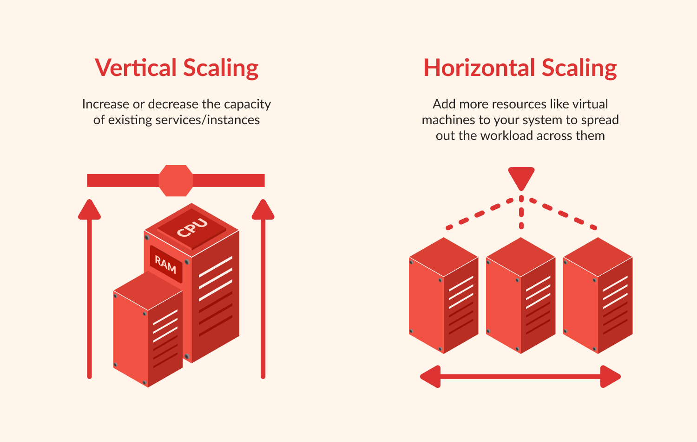
Scalability and Growth
Why Scalability Matters:
Entrepreneurial systems are designed for future growth.
Scalability Considerations:
• Increasing number of users
• Growing data volume
• Performance under peak load
• Modular and extensible architecture
Agile / DSDM Link:
Captured through Non-Functional Requirements.

Slide 20
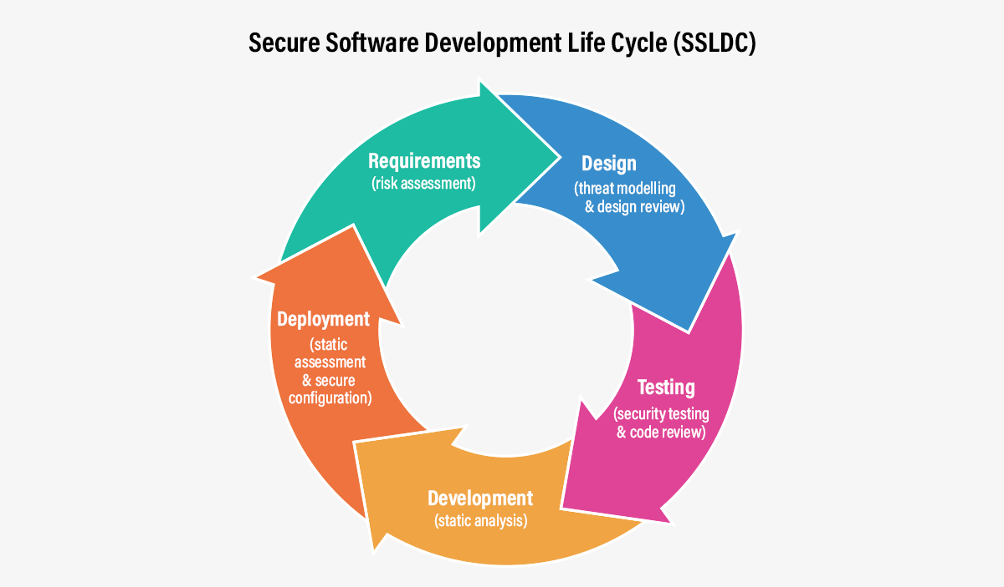
Security in Software Project Management

Slide 21
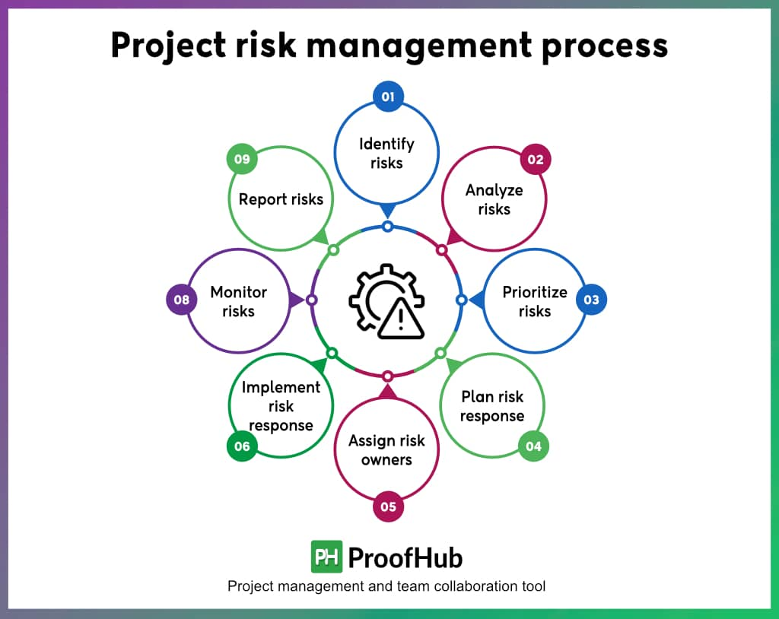
Security in Software Project Management
Security as a Business Enabler:
Security protects reputation, trust, and revenue.
Security Considerations:
Data confidentiality and privacy
Access control and authentication
Regulatory compliance (e.g. GDPR, PDPA)
Risk assessment and mitigation
Agile / DSDM Link:
Security requirements treated as Must Have NFRs
Managed continuously throughout the lifecycle

Slide 22
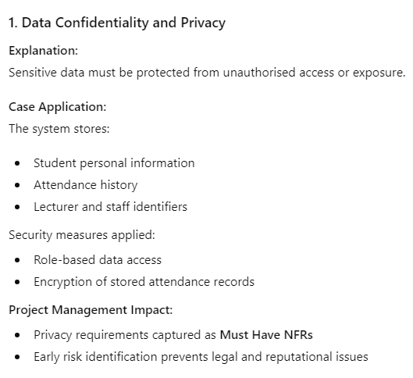
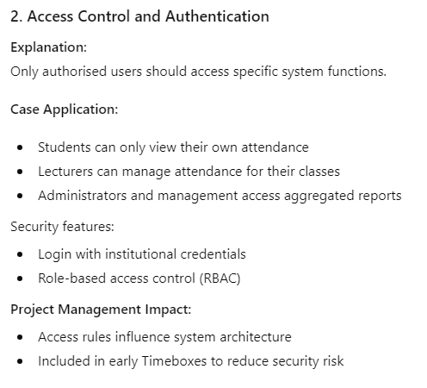
Security Considerations

Slide 23
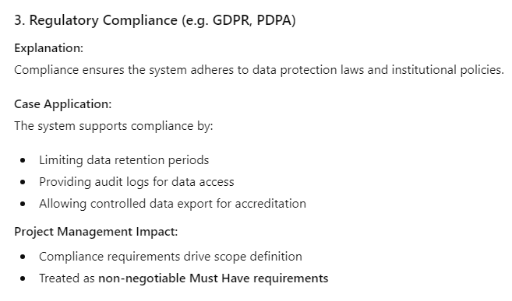
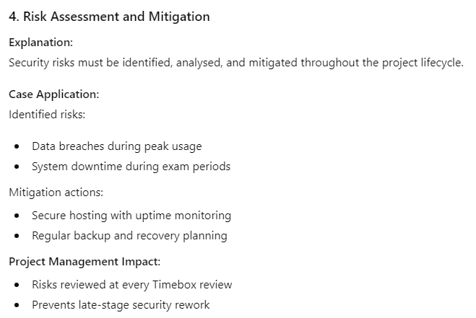
Security Considerations

Slide 24
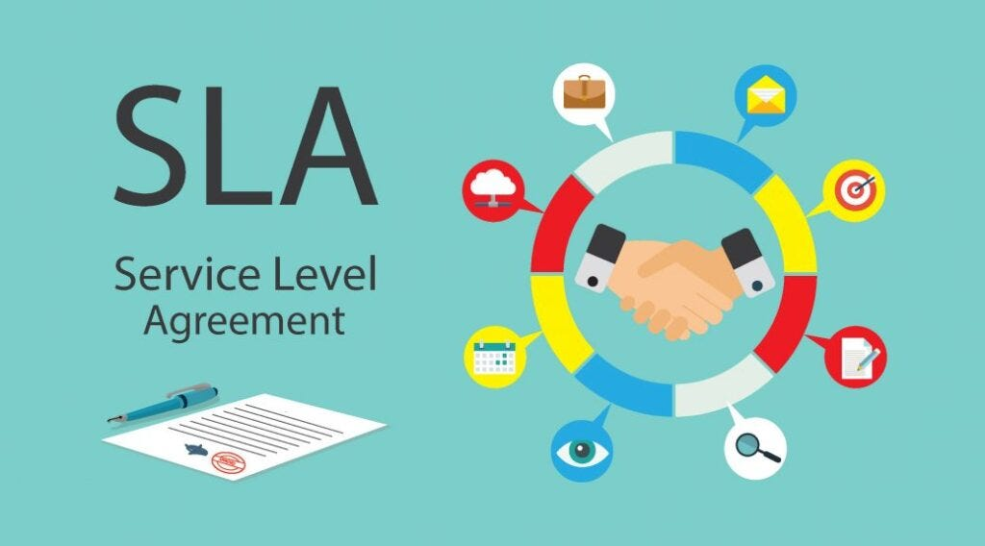
Service Level Agreement (SLA)

Slide 25
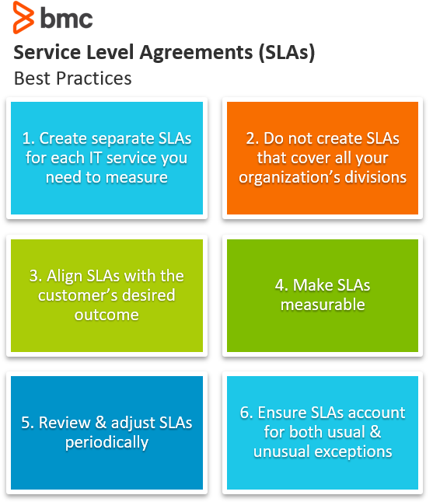
Service Level Agreement (SLA)
What is an SLA?
A formal agreement defining service expectations.
Typical SLA Elements:
• System availability
• Response and resolution times
• Performance benchmarks
• Security clauses
• Penalties for non-compliance
Agile / DSDM Link:
Influences estimation and prioritisation.

Slide 26
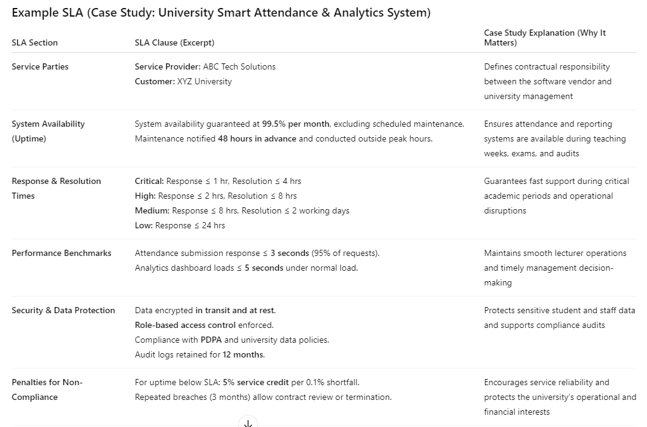

Slide 27

Integration of Information Security

Slide 28
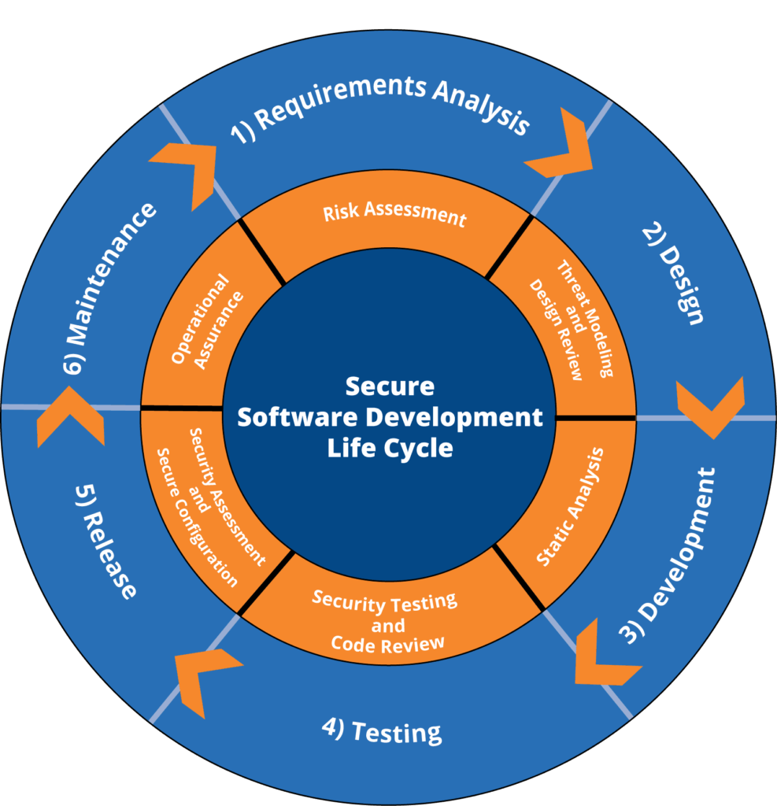
Integration of Information Security
Security by Design:
Security embedded throughout the lifecycle.
Key Practices:
• Secure architecture design
• Data encryption
• Secure APIs
• Regular security testing
Agile / DSDM Link:
Integrated into every Timebox.

Slide 29

Educating Team Members on Security

Slide 30
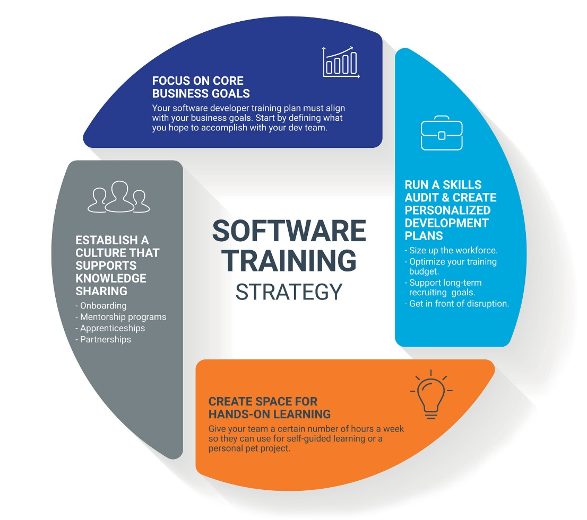
Educating Team Members on Security
Why Team Education Matters:
Human error is one of the largest security risks.
Education & Awareness Activities:
• Secure coding practices
• Awareness of common attacks
• Incident response procedures
• Compliance and ethics
Agile / DSDM Link:
Supports empowered, self-organising teams.

Slide 31
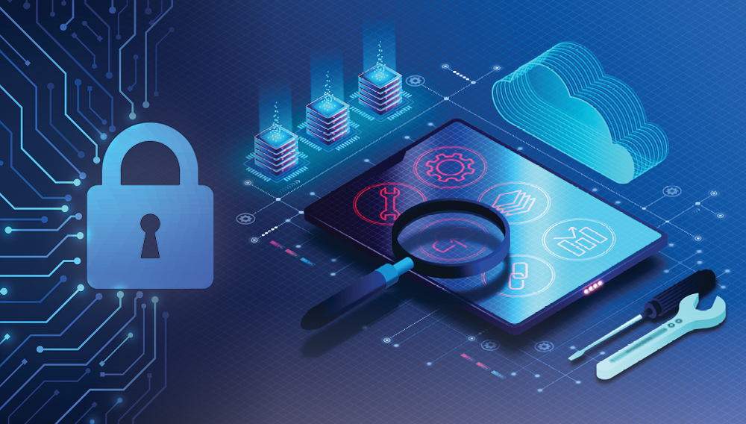
Use of Security Tools

Slide 32
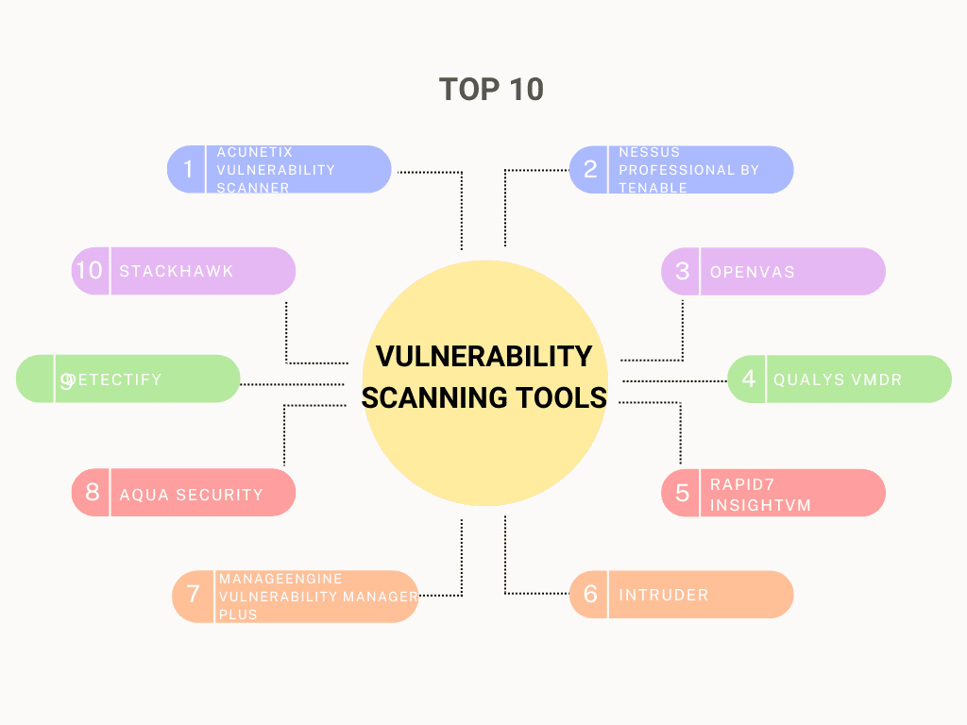
Use of Security Tools
Role of Security Tools:
Support automation and detection.
Examples of Security Tools:
• Static and dynamic code analysis
• Vulnerability scanners
• Identity and access management
• Logging and monitoring systems
Agile / DSDM Link:
Integrated into CI/CD pipelines.

Slide 33

Summary: Entrepreneurial Mindset in Agile DSDM

Slide 34
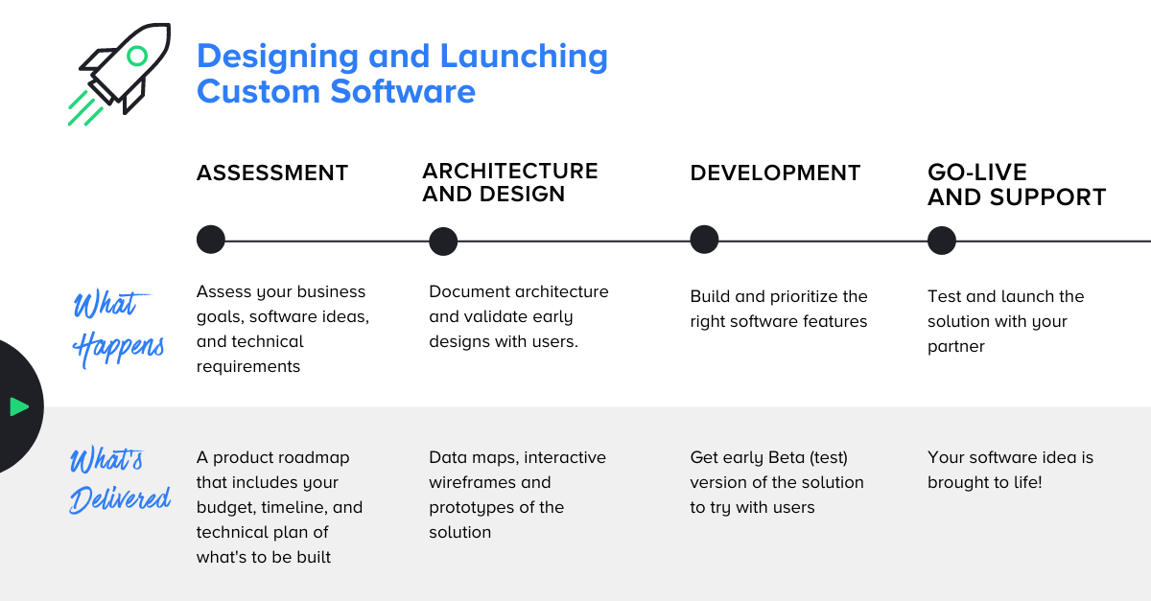
Summary – Entrepreneurial Mindset in Agile DSDM
Key Takeaways:
• Entrepreneurial mindset aligns Agile delivery with business success
• Combines market awareness, revenue thinking, scalability, and security
• Supports DSDM principles of business focus, quality, and sustainability
DSDM Impact
Supports DSDM principles of:
Business focus
Built-in quality
Continuous delivery
Long-term sustainability

Slide 35









THANK YOU
In the Name of God for Mankind
www.utm.my

